Slide 1
Autonomous Intersection Management
Agartha

Slide 2
Agenda
01. Problem
02. Requirements
03. Architecture
04. Implementation
05. Scheduling

Slide 3
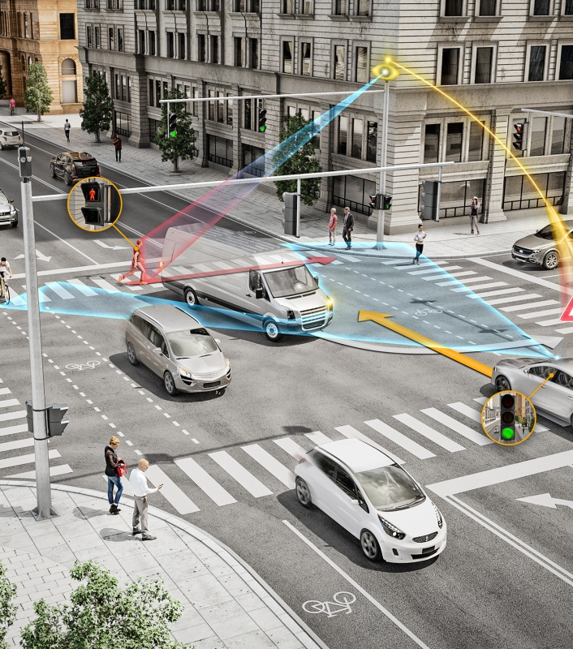
Problem
The intersection plays an important role in the traffic network, which is also one of the main causes of traffic accidents.

Slide 4
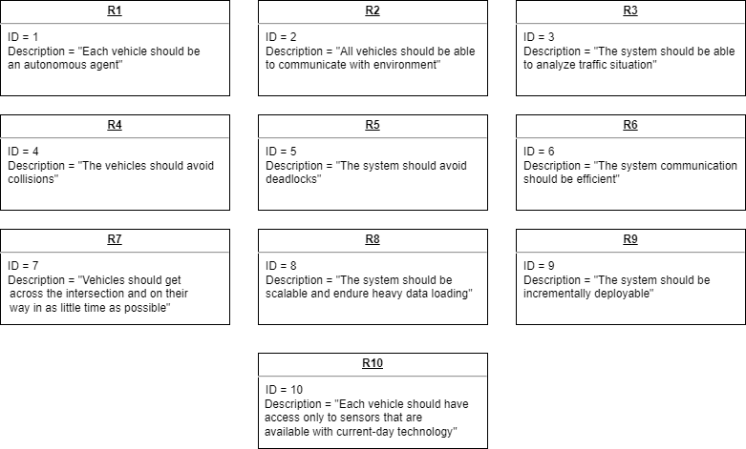
Requirements

Slide 5
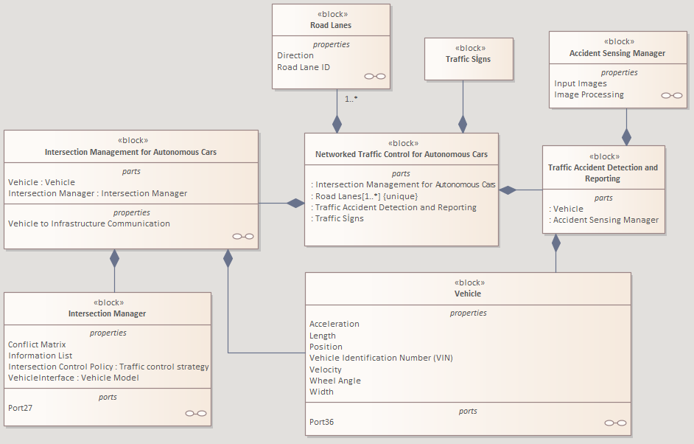
Architecture Context

Slide 6
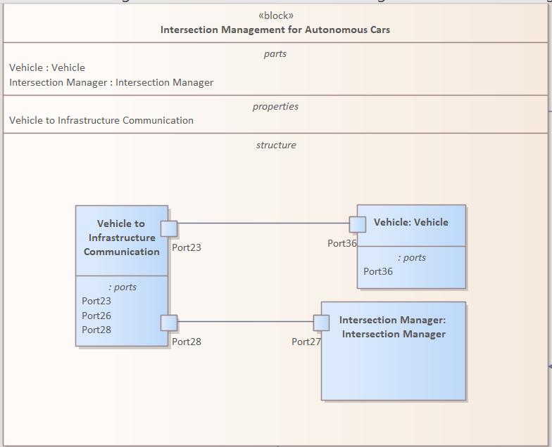
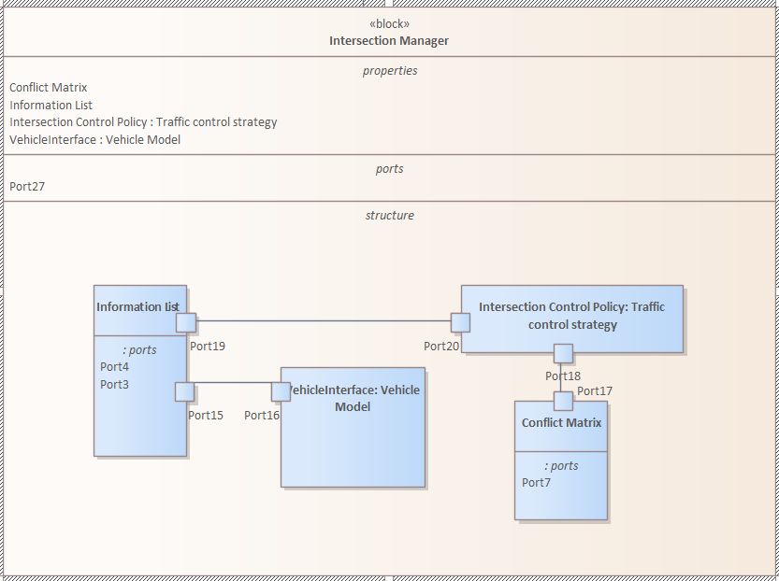
Architecture - Internal Blocks

Slide 7
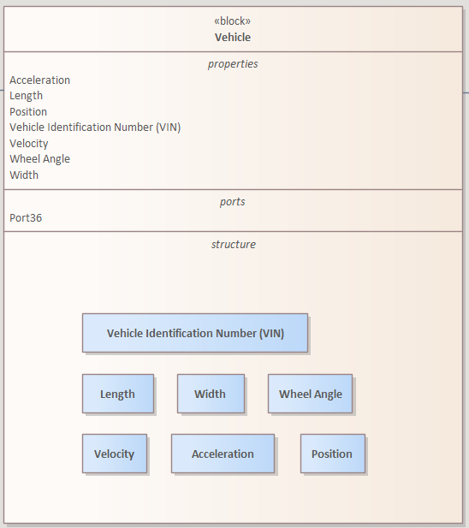
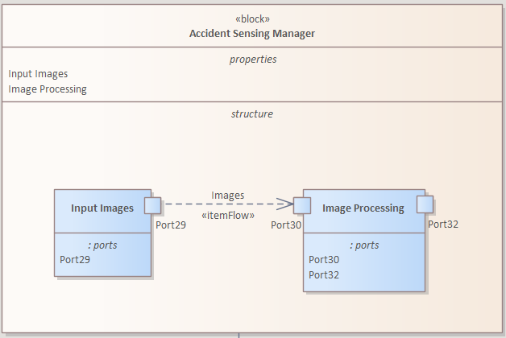
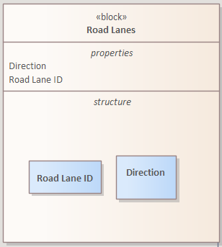
Architecture - Internal Blocks

Slide 8
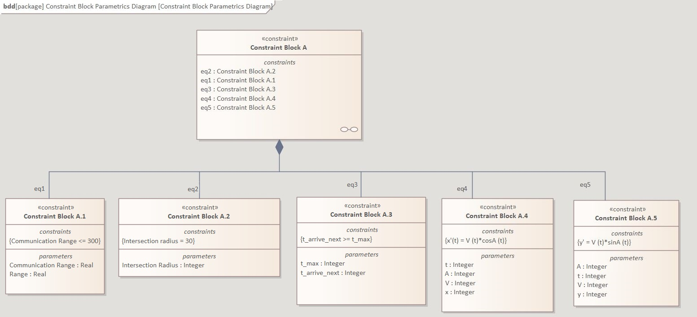
Architecture - Constraints

Slide 9
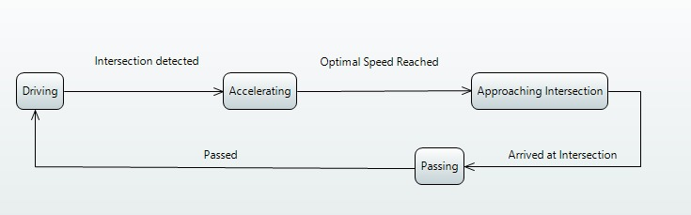
Architecture – State Machines
Vehicle

Slide 10
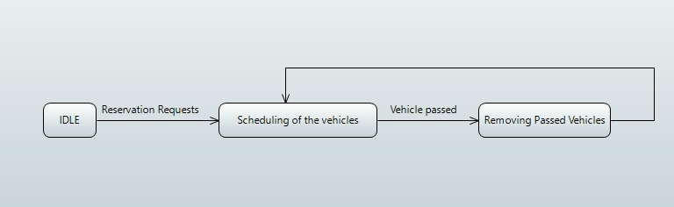
Architecture – State Machines
Intersection Manager Unit

Slide 11
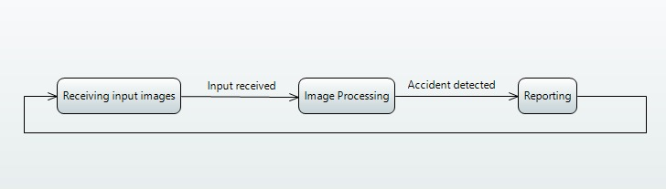
Architecture – State Machines
Accident Detection Unit

Slide 12
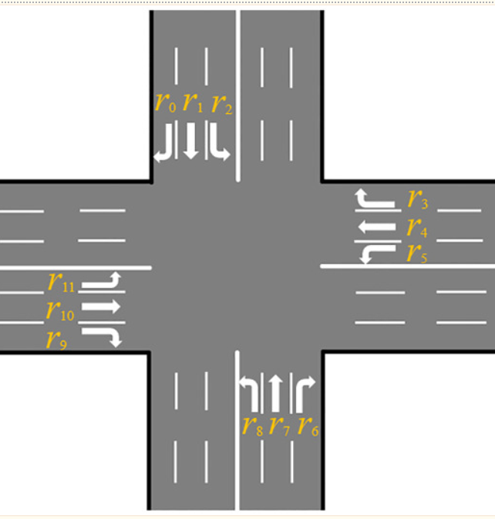
Scenario

Slide 13
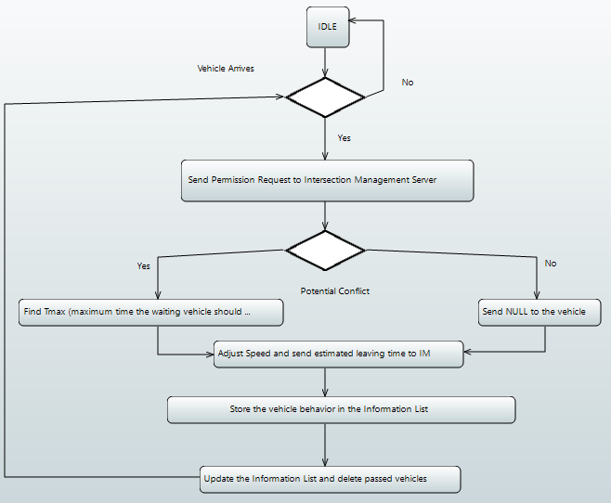
Implementation – Behaviour

Slide 14
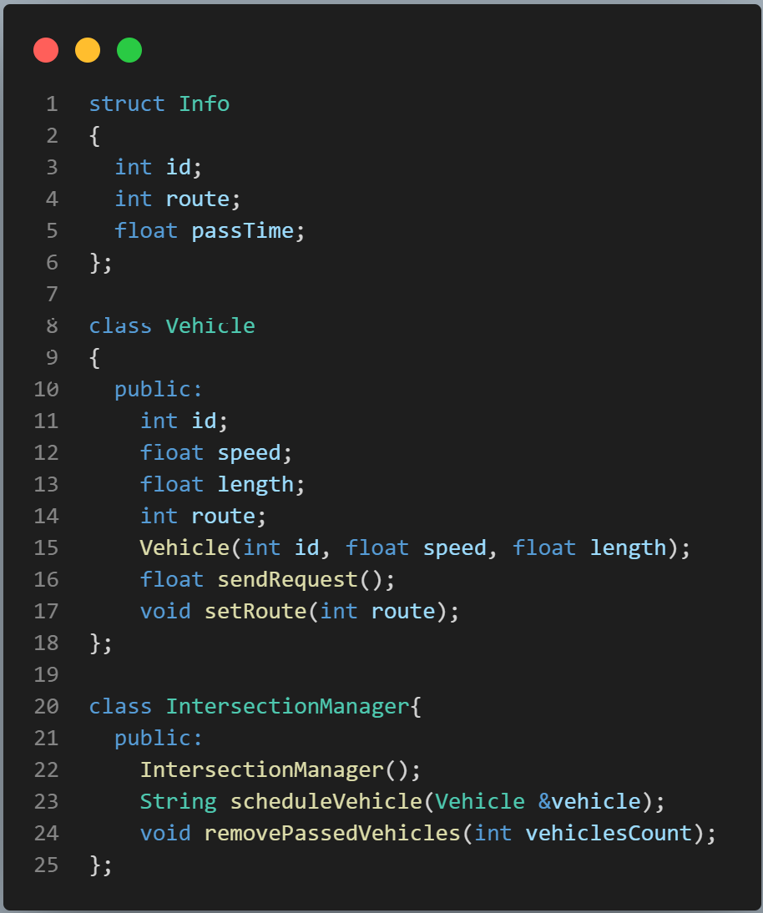
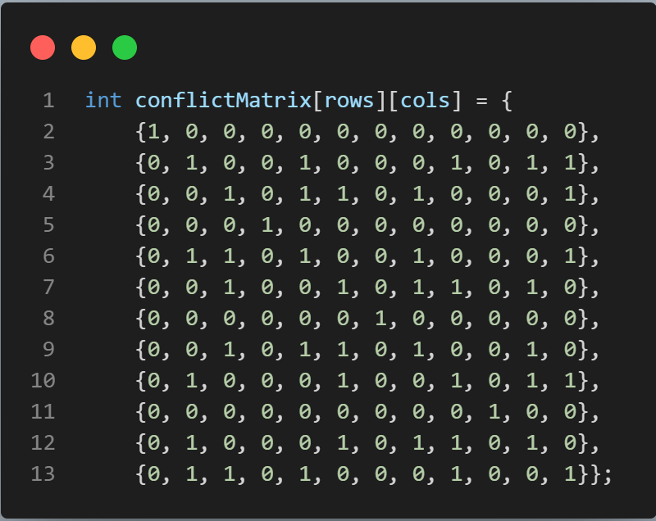
Implementation – Data Model

Slide 15
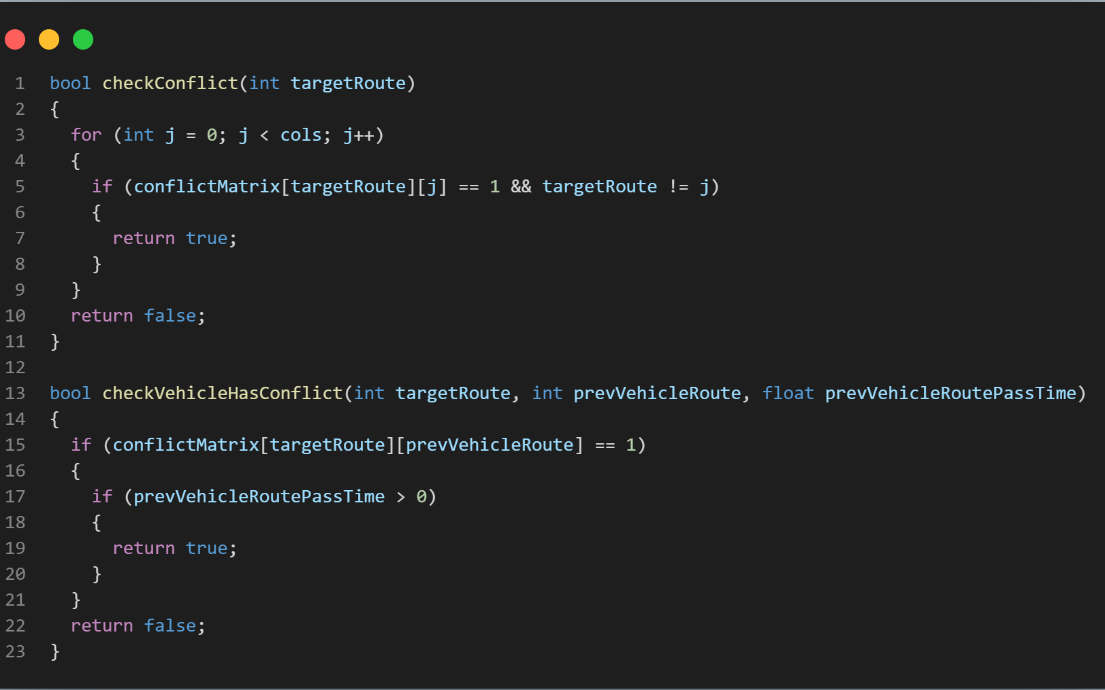
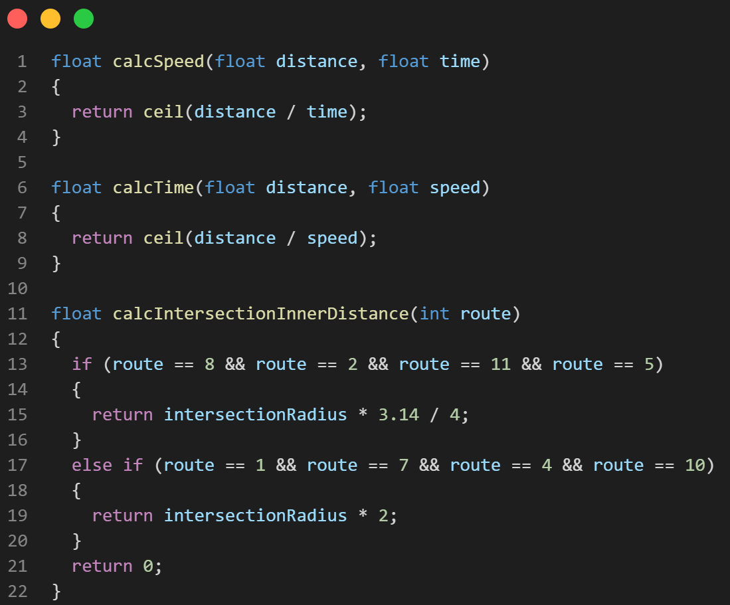
Implementation - Functions

Slide 16
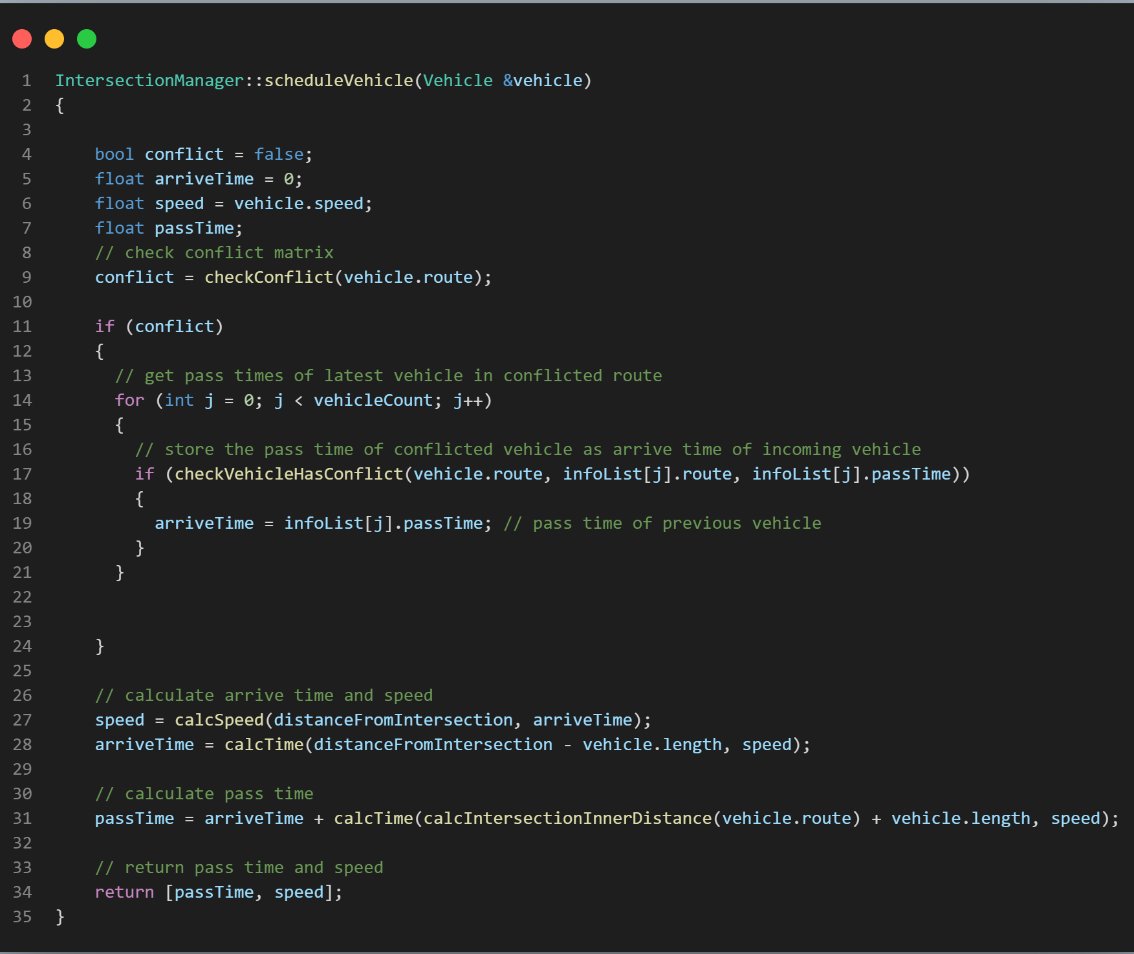
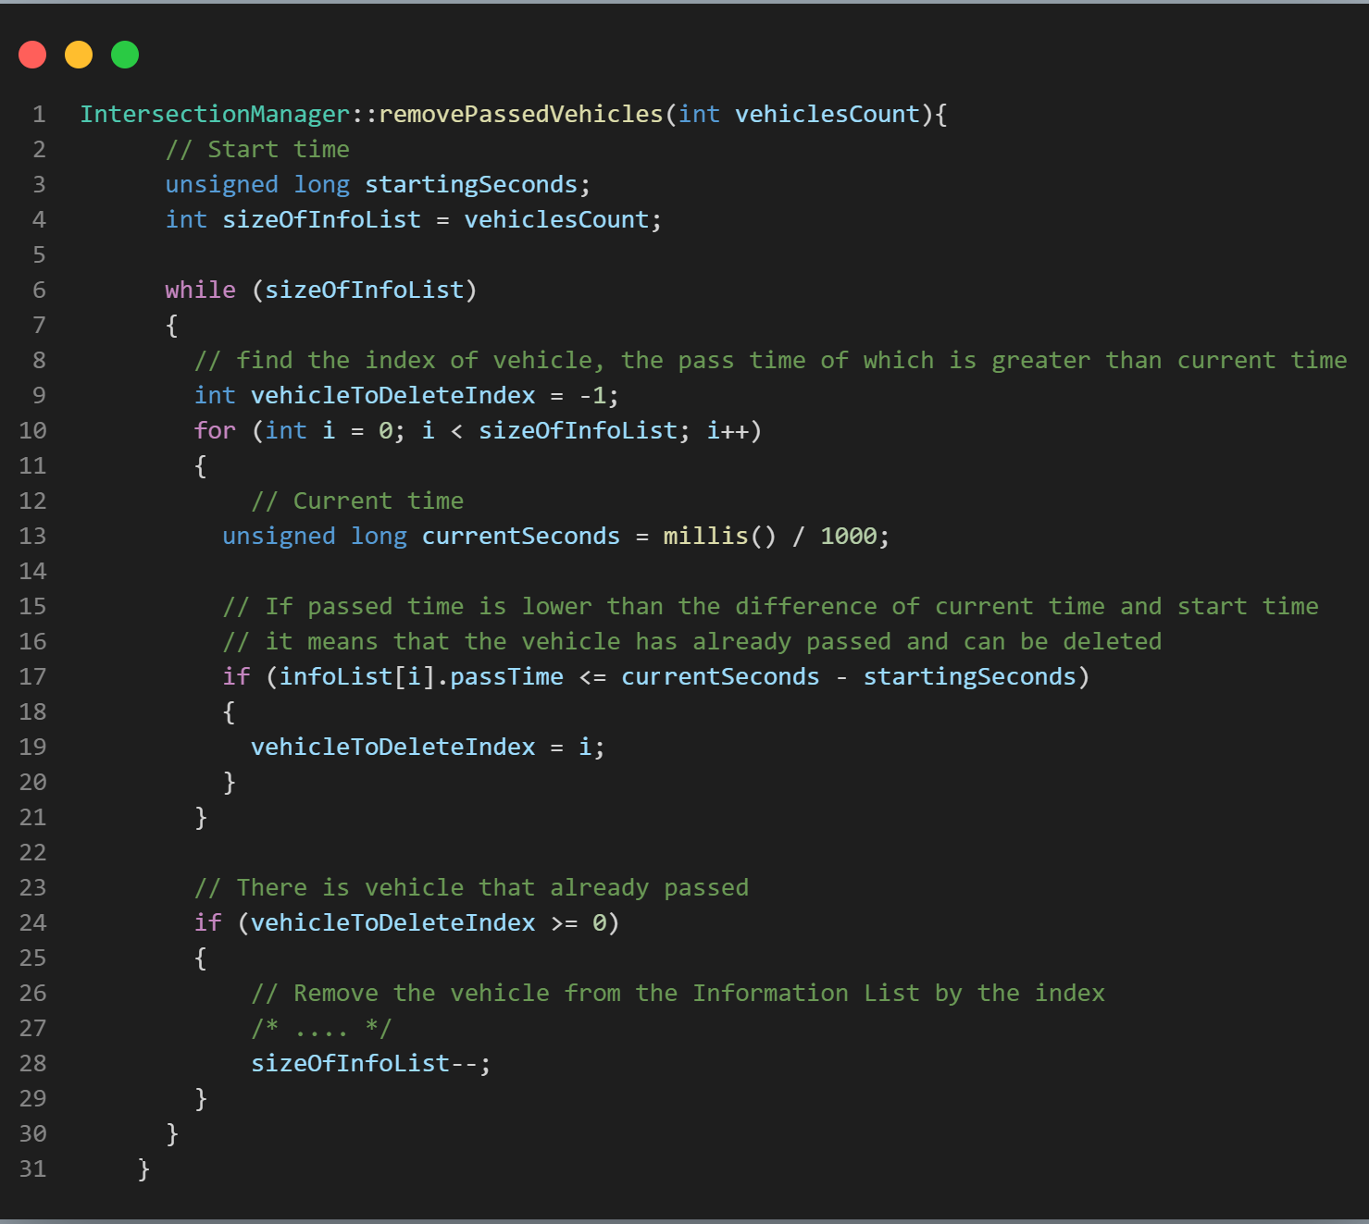
Implementation – Intersection Manager Behavior

Slide 17
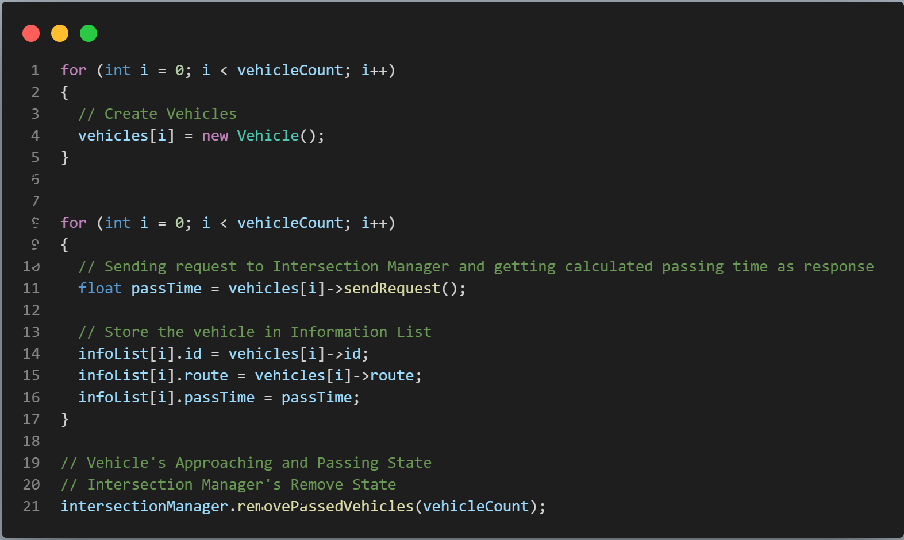
Implementation – Main Flow

Slide 18
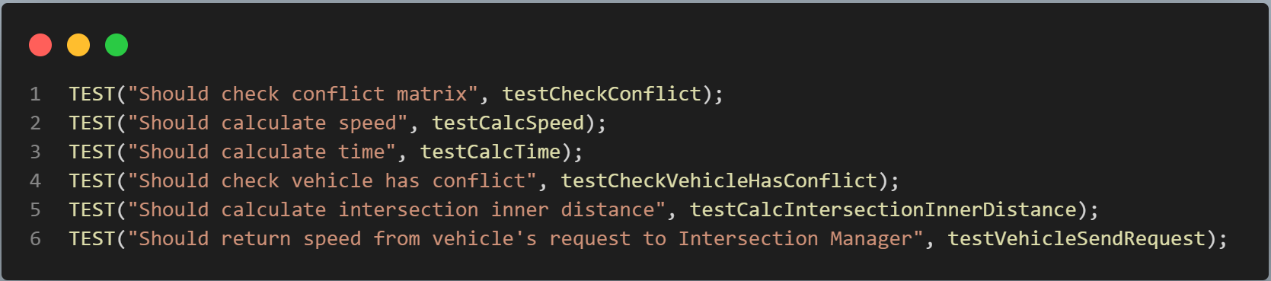
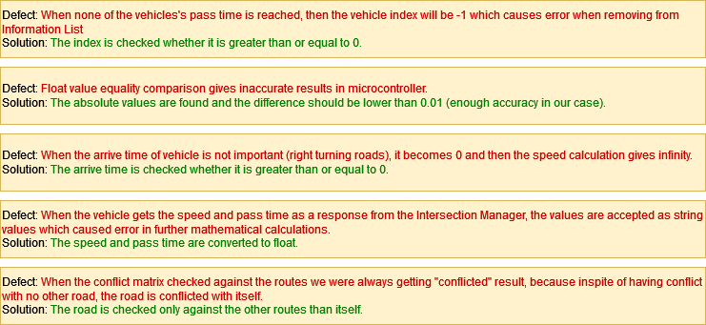
Implementation - Testing

Slide 19
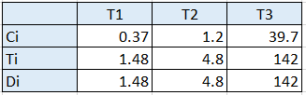
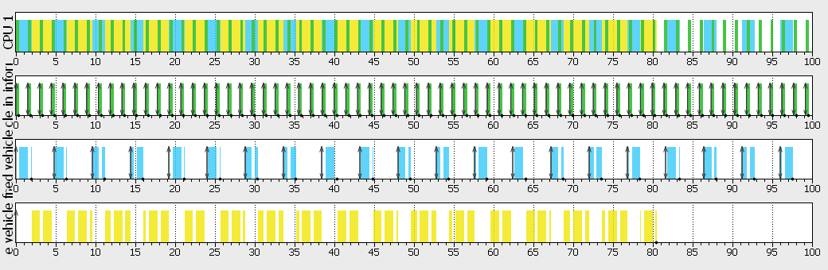

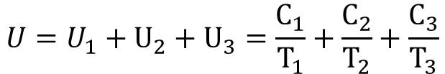
Scheduling
$$U=U_{1}+U_{2}+U_{3}=\frac{C_{1}}{T_{1}}+\frac{C_{2}}{T_{2}}+\frac{C_{3}}{T_{3}}$$
$$U=0.7796<1$$
Earliest Deadline First

Slide 20


Scheduling
$$U=U_{1}+U_{2}+U_{3}=\frac{C_{1}}{T_{1}}+\frac{C_{2}}{T_{2}}+\frac{C_{3}}{T_{3}}$$
$$U_{RM}=n∗(2^{\frac{1}{n}}−1)$$
Rate Monotonic
$$U=0.7796<U_{RM}=0.7798$$

Slide 21

Thank you

